Slide 1

By:- MAKOUNDOU Paule-Theodora
DE TROGOFF Guilhem
SHARMA Karan
LEDROLE Pierre

Slide 2

What is ElasticSearch ?
Elasticsearch is a BASE (Basically Available, Soft State, Eventually Consistent) system.
Prioritizes availability and scalability over strict consistency.
Stores and indexes JSON documents for fast search and retrieval.

Slide 3

Examples of Data Stored in Elasticsearch
Logs and Event Data: System and application logs.
Full-Text Documents: Articles, product descriptions.
Structured Data: User information, product details.
Geospatial Data: Geographic coordinates, maps.
Time-Series Data: Metrics, financial data.
Social Media Data: Posts, user interactions.
Machine Learning Data: Training sets, predictions.

Slide 4
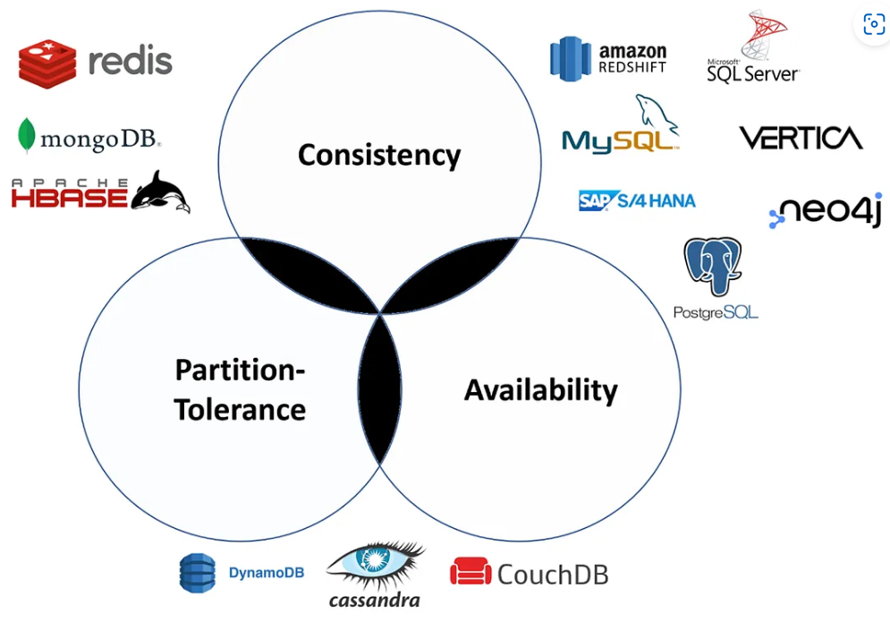
CAP theorem positioning
Consistency: Ensures data across nodes is synchronized.
Partition Tolerance: Continues operating despite network issues.
Availability: Sacrifices some availability during network partitions to maintain consistency.

Slide 5




Examples of Uses
Uses: Used by companies like Netflix and GitHub. Powers search engines for platforms like Wikipedia and Shopify.
Issues: High resource usage (RAM, CPU), complex cluster management, risk of data loss from poor configuration.
Cost: Free for the open-source version; paid options offer advanced features. Managed Elastic Cloud services simplify setup but increase costs

Slide 6
How Popular is this Tool?
ElasticSearch is widely popular, especially in IT,
e-commerce, and media.
Major companies like Netflix, Uber, and Shopify rely on it
Strong community support, frequent updates, and
adaptability for real-time, large-scale search needs.

Slide 7



Main Competitors
Competitors: Apache Solr (open-source), Splunk (commercial), Amazon CloudSearch (managed), and Lucenefor custom search.
Timeline: Released in 2010, evolved with ELK integration, cloud offerings, and machine learning features.

Slide 8
Future and Market Changes
ElasticSearch is expected to expand:
in machine learning
in cloud services.

Slide 9

Benefits and limitations
Benefits: Highly scalable, real-time search and analytics, flexible full-text search capabilities, open-source with strong integration options.
Limitations: No ACID compliance (BASE model), complex cluster management, high resource demands increase operational costs.

Slide 10
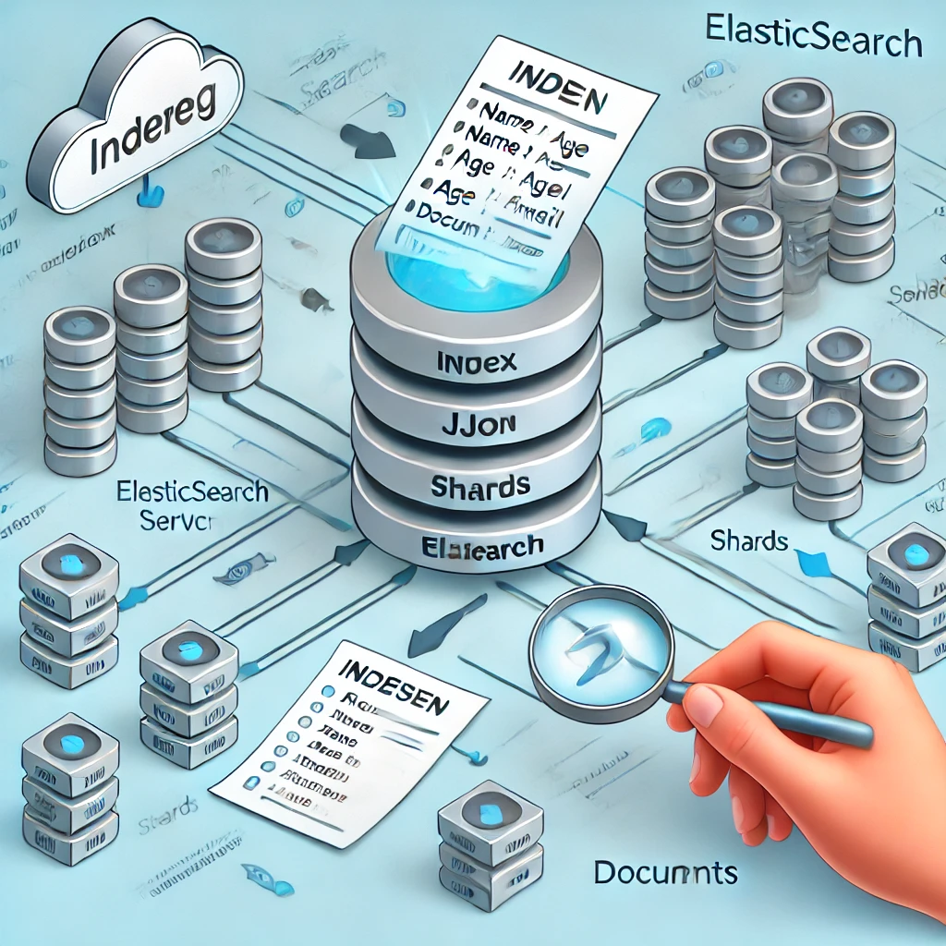
Indexing in Elasticsearch and its code implementation
Indexing in Elasticsearch is essentially the process of storing and organizing data so that it can be efficiently searched and retrieved. When we index a document, we add it to an index (like a table in SQL) where it becomes searchable.
Index: A collection of documents (like a table in SQL).
Document: The basic unit of information (like a row in SQL) containing various fields (key-value pairs).
Field: Each key-value pair in a document (like columns in SQL).
Shards: Indexes are split into smaller units called shards, which allow Elasticsearch to distribute data across multiple nodes for scalability and performance.

Slide 11
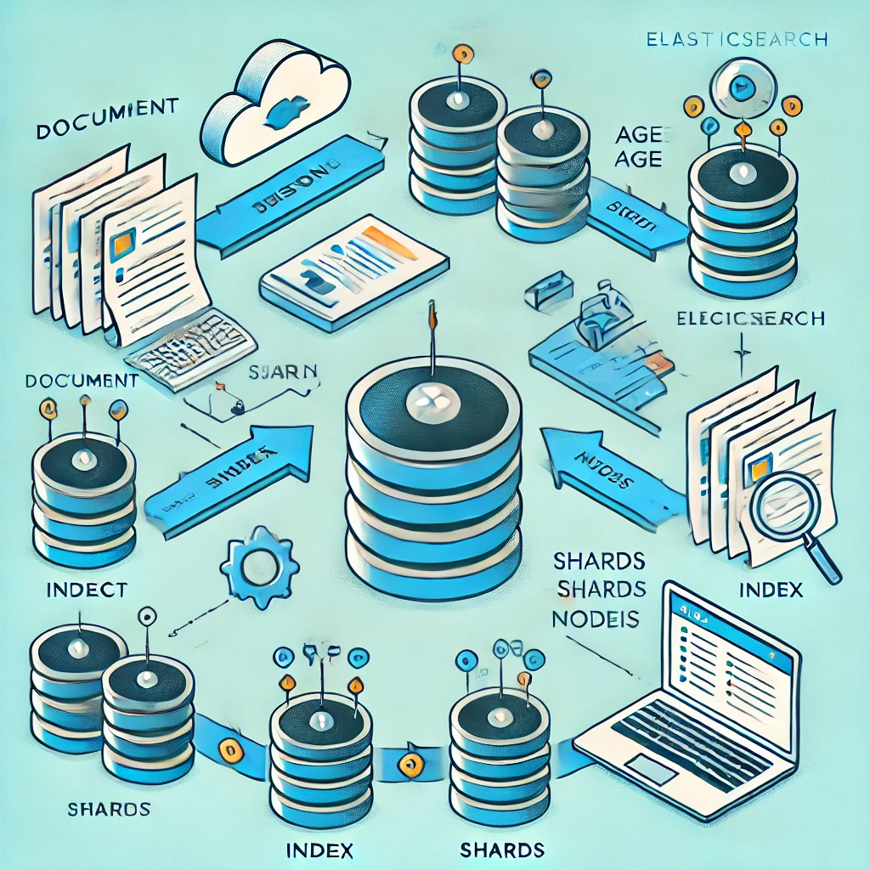
The Indexing Process:
Parsing: Elasticsearch breaks down a document into its individual fields during indexing.
Mapping: Elasticsearch automatically maps field types (or you can define your own mappings), telling Elasticsearch how to store and search the data.
Inverted Index: For text fields, Elasticsearch creates an inverted index that allows for fast full-text search by mapping terms to the documents that contain them.

Slide 12
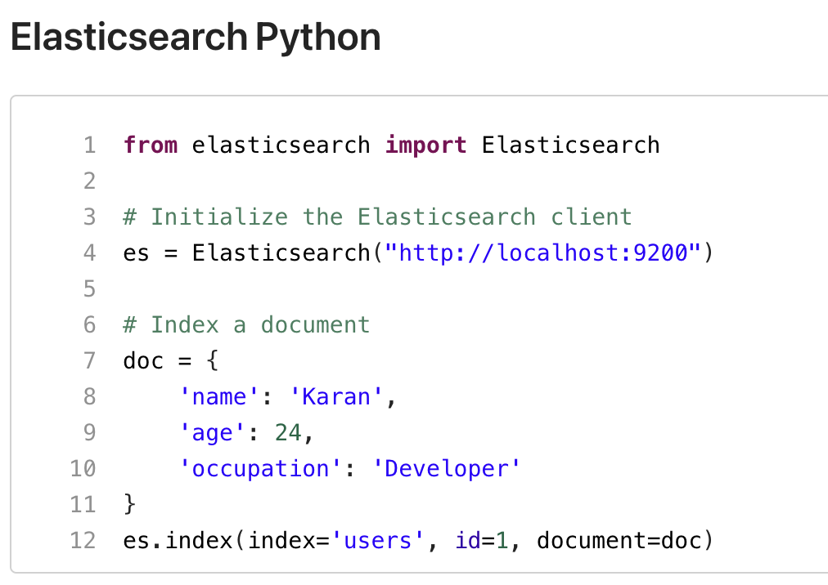
Code Example (Python):
Indexing a document into Elasticsearch:

Slide 13
Similarities with SQL and Code Comparison
Similarities with SQL:
Indexes vs. Tables: In Elasticsearch, indexes are similar to tables in SQL. Both are used to store collections of documents (rows).
Documents vs. Rows: In Elasticsearch, a document is like a row in SQL.
Fields vs. Columns: Elasticsearch’s fields correspond to columns in SQL.
Queries: Both Elasticsearch and SQL allow filtering and searching based on conditions.
Aggregations: Elasticsearch aggregations are similar to SQL aggregate functions (e.g., COUNT, SUM, AVG).

Slide 14
Key Differences:
Full-Text Search: Elasticsearch excels at full-text search, while SQL is not optimized for it.
Schema: Elasticsearch is schema-less, whereas SQL databases require a predefined schema.
Joins: SQL supports complex joins between tables, while Elasticsearch is document-based and does not support traditional joins.

Slide 15
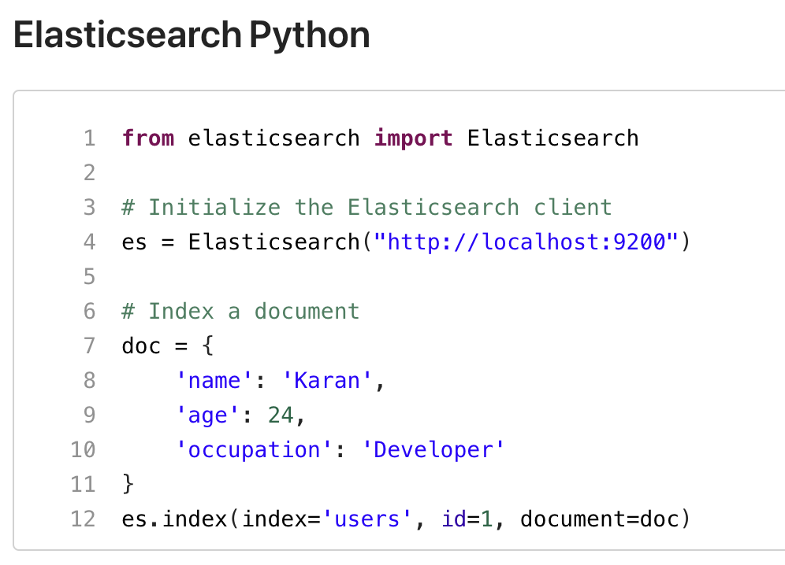
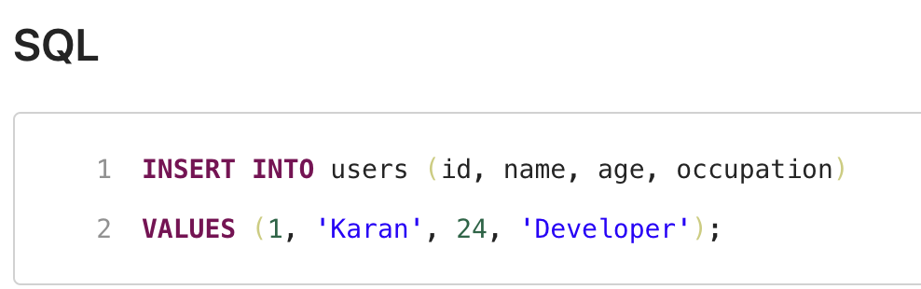
Code Comparison (Examples): Insert a row:

Slide 16
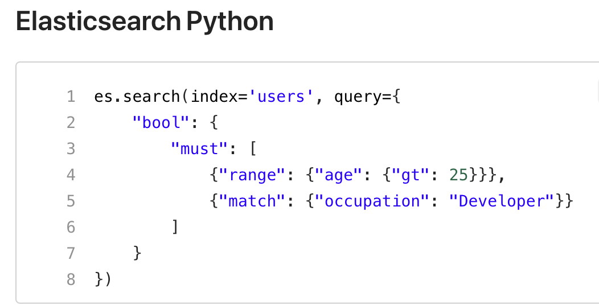
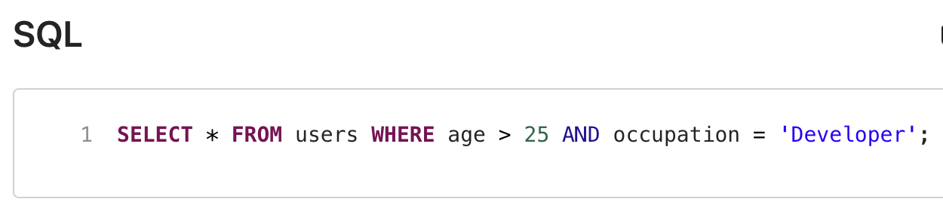
Query with conditions:

Slide 17
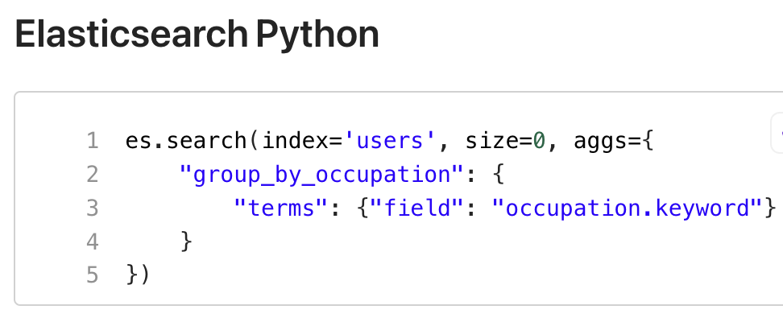
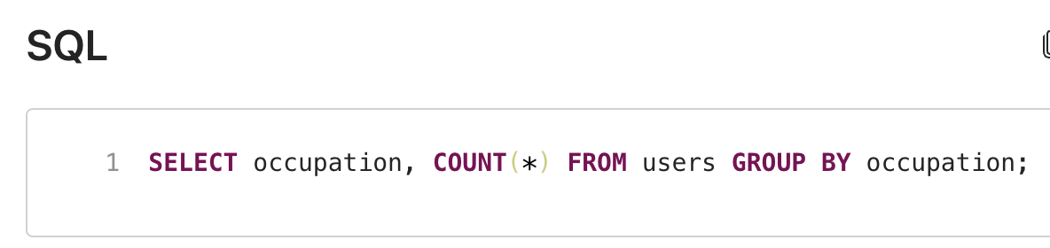
Aggregate (COUNT) and group by:

Slide 18

Scalability:
Elasticsearch is designed to be highly scalable. As your data grows, Elasticsearch can scale horizontally by adding more nodes to your cluster. Key features like sharding and replication make it resilient and able to handle large volumes of data efficiently.
Sharding: Each index is divided into shards, which are distributed across multiple nodes.
Replication: Shards are replicated to provide high availability. If a node goes down, Elasticsearch will use replica shards to ensure data availability.

Slide 19
Flexibility
One of Elasticsearch's greatest strengths is its flexibility. It handles structured, semi-structured, and unstructured data seamlessly. You can store:
Text and perform full-text search.
Numbers, dates, and booleans for structured queries.
Arrays and nested objects for more complex data models.
Geospatial data for location-based searches.
Elasticsearch is also schema-less by default, meaning you don’t need to define a rigid structure upfront. You can index and search a wide variety of data types without setting up predefined mappings (though you can define mappings if needed).

Slide 20
Usability
RESTful API: You can interact with Elasticsearch using simple HTTP requests (e.g., GET, POST), making it easy to use and integrate with different tools.
Kibana: Kibana, part of the Elastic Stack, allows you to visualize and explore your data using a graphical interface. This makes Elasticsearch accessible to technical and non-technical users alike.
Real-Time Data Ingestion: Elasticsearch indexes data in near real-time, meaning new data becomes searchable almost immediately after it's ingested.

Slide 21


